Slide 1
Non-Sociological Approaches
V
Labelling Approaches
Sociological
And
Non-Sociological
Approaches
To
Crime and Deviance

Slide 2
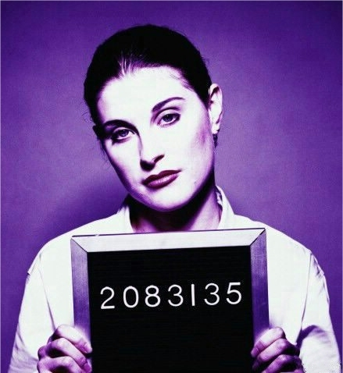
For example, deviants are seen as “psychologically-damaged” individuals
Non-Sociological Approaches
1. Focus on the biological, genetic and psychological characteristics of deviants.
There is something different about people who “break the rules”
2. Deviants are qualitatively different to
non-deviants.
Crime and deviance have causes that can be discovered and isolated.
3. Discovering the characteristics shared by deviants (and absent in non-deviants) will reveal the causes of crime.
Why are some people “predisposed” to rule-breaking behaviour?
4. Deviance is a quality of what you are and what you do.
Focus is on how and why individuals break social rules.
5. Focus on individualistic explanations of deviance.
Deviance is not a quality of how people react to the behaviour of others – some forms of behaviour are always considered deviant…
6. Deviance is an absolutist concept.

Slide 3
Labelling Approaches
Deviants are people whose behaviour is labelled as “deviant”
1. Focus on how people react to the (deviant) behaviour of others.
Everyone breaks social rules – deviants are simply people who are identified for special treatment…
2. Deviants are not characteristically different to non-deviants.
The same behaviour can be seen as deviant / non-deviant at different times and in different places.
3. Deviance is not a quality of what you do but a quality of how others react to what you do…
Deviance is socially-constructed; there are no simple “causes” of crime to discover…
4. It is impossible to discover hard-and-fast “causes of crime”
Focus is on how and why societies create social rules.
5. Focus on explanations based on the social construction of crime and deviance.
What counts as deviance changes historically (over time) and cross-culturally (between societies).
6. Deviance is a relative concept.

Slide 4
Identify examples of the same behaviour considered deviant / non-deviant at different times and places…
Labelling Approaches:
Deviance as a Relative Concept…
Historical Examples
(same society at different times)
Cross Cultural Examples
(different societies)
Homosexuality
Drinking alcohol

