Slide 1
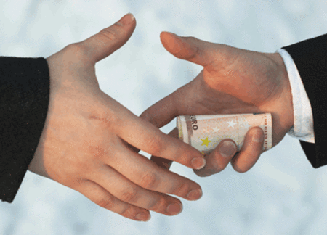
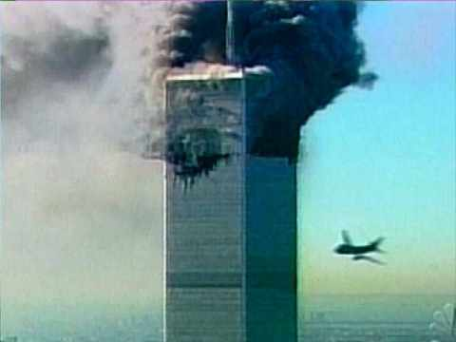
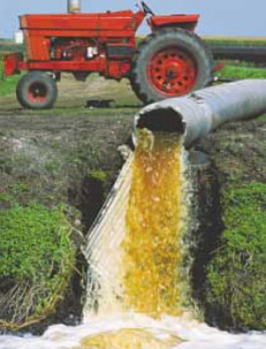
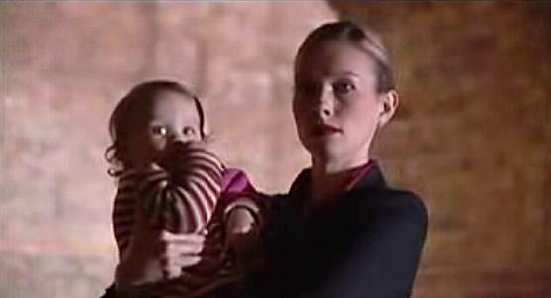
Each slide can be advanced using a mouse click. Alternatively, moving the cursor to the:
Right Hand edge of the screen moves the presentation forward to the next slide.
Left Hand edge of the screen moves the presentation back to the previous slide.
The Crime and Deviance Channel
Contemporary
Issues
Globalisation and
Transnational Crime
Notes:
Navigation:
Each slide can be advanced using a mouse click.
Alternatively:
Moving the cursor to the Right Hand side of the screen moves the presentation forward to the next slide.
Moving the cursor to the Left Hand side of the screen moves the presentation backward to the previous slide.

Slide 2
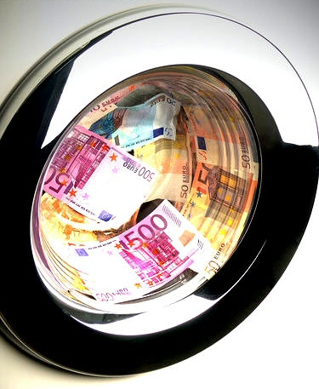
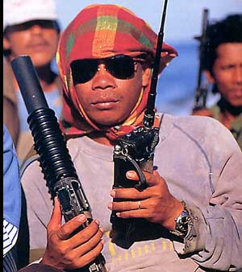
globalisation introduces a range of social changes that have created opportunities for both legal and illegal global activities – some of which are new and exist only because of the development of worldwide computer technologies and networks, others of which have been given a new lease of life by their internationalisation.
1. Conventional forms of crime facilitated by globalisation

Slide 3
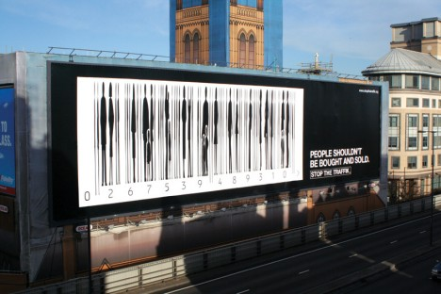
Trafficking:
takes a number of forms, from drugs and weapons (both arms and the materials - biological, chemical and nuclear – that could potentially be used as weapons of mass destruction), through people (such as women being sold into sex slavery and children sold into domestic slavery) to body parts, endangered species and gemstones…

Slide 4
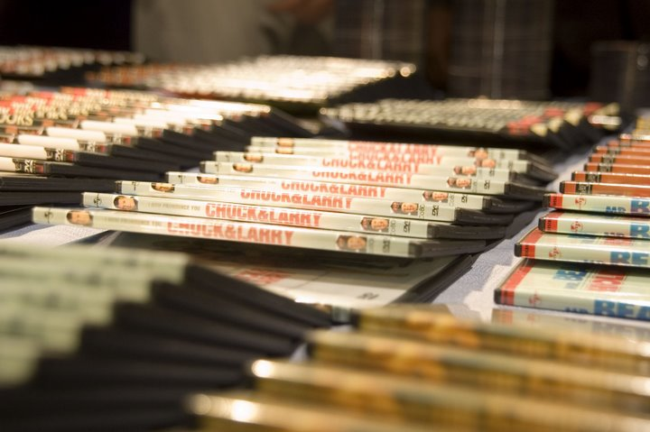
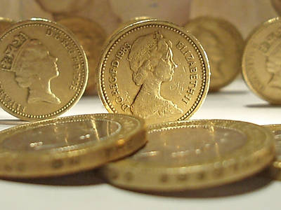
Counterfeiting:
Involves both money (US dollars are currently the most commonly counterfeited currency in the world and the Royal Mint has estimated there are currently (2009) around 30 million fake £1 coins in circulation in Britain) and goods (such as music CDs, DVDs, designer goods and the like).

Slide 5
Money Laundering:
the ability to “clean” money gained through illegal activities using a variety of means, such as investing illegal profits in legitimate businesses (or even setting up such businesses using “dirty” money); the profit made by the legitimate business then becomes “clean money”. laundering provides a seemingly legal source of wealth for people who would otherwise have to explain a lifestyle that had no legitimate means of support.

Slide 6
Intellectual Property Rights:
involves things like the theft of trade secrets, trademark and patent infringements, many of which are related to counterfeiting and the illegal manufacture and distribution of goods. The best-known form of this type of behaviour is probably illegal music downloads and copying, although so-called pirated DVD films are also included here.

Slide 7
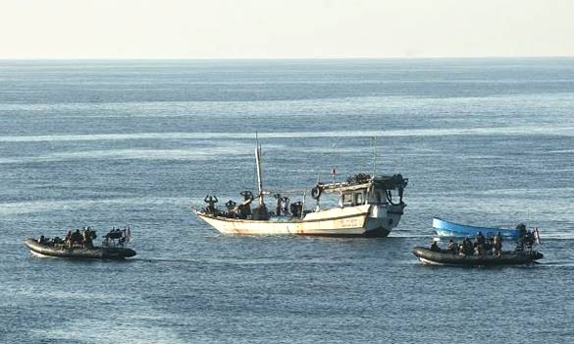
Piracy:
Real (as opposed to copyright infringement) piracy is a form of conventional crime given a new lease of life by globalisation and computer technology. Pirates were particularly active in the 17th century, for example; their contemporary counterparts use satellite phones and global positioning systems (GPS) as part of their standard equipment.

Slide 8
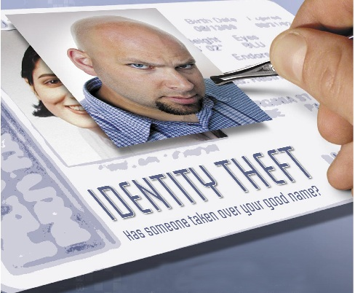
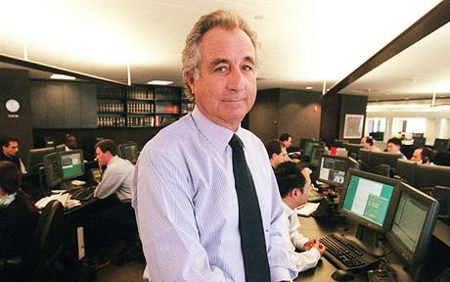
Financial Fraud:
reflects a wide-range of behaviours, some of which
involve computers and the internet:
Advance fee frauds: a criminal poses as someone with access to (nonexistent) hidden government or private funds they will share with the victim “for a fee”.
Phishing: Criminals gain access to individual bank accounts by posing as representatives of said bank.
Other forms involve stolen credit cards, identity theft and the like.

Slide 9
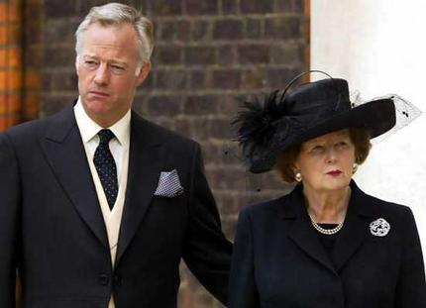
Bribery and Corruption:
huge contracts for buildings, oil pipelines, defence and the like are frequently put out to competition around the world – a situation that provides opportunities for bribery and corrupt business practices on a Massive scale. The situation is frequently confused by attempts to redefine “bribery” as “commission” for services rendered.

Slide 10
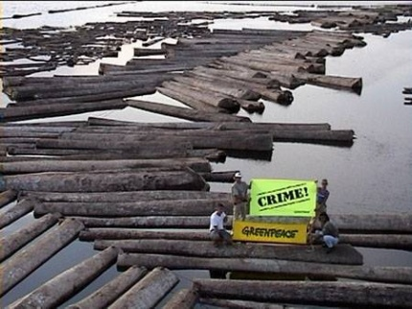
Environmental Crimes:
Involves a range of activities – such as dumping hazardous waste, the illegal extraction of rare natural resources and the smuggling of products (such as CFCs) known to harm the environment. There is strong evidence such crime is both well-organised by criminal gangs in Eastern Europe and Africa and carried-out by legitimate businesses as part of their everyday operations.

Slide 11
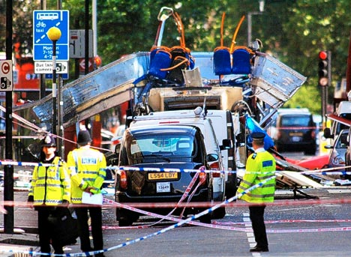
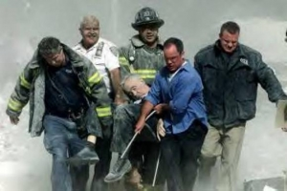
Terrorism:
A final example of transnational crime is one that has become increasingly well-known across the globe, with two terrorist attacks in America being particularly symbolic of this type of criminal activity – the bombing of the World Trade Center (sic) in 1993 and the 9/11 attacks on the same target.

