Slide 1
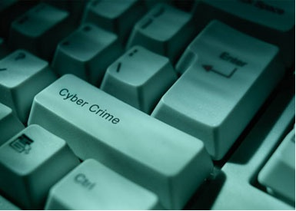
Each slide can be advanced using a mouse click. Alternatively, moving the cursor to the:
Right Hand edge of the screen moves the presentation forward to the next slide.
Left Hand edge of the screen moves the presentation back to the previous slide.
The Crime and Deviance Channel
Contemporary
Issues
Globalisation and
Transnational Crime

Slide 2
globalisation introduces a range of social changes that have created opportunities for both legal and illegal global activities – some of which are new and
exist only because of the development of worldwide computer technologies and networks, others of which have been given a new lease of life by their internationalisation.
2. New forms of crime
facilitated by globalisation

Slide 3
Cybercrime:
generic term describing a range of criminal activities explicitly facilitated or generated through the development and application of computer technology.
Surin (2003):
Crime committed over the Internet / any crime that is committed by means of special knowledge or expert use of computer technology.
Symantec Corp. (2006):
Any crime committed using a computer...The computer may be the agent, the facilitator or the target of the crime.

Slide 4
Computer crime:
Crimes that use computer technology as the primary method of commission.
▪ Phishing frauds
▪ Identity theft
▪ Theft of Data
▪ electronic money laundering
Although crimes themselves may be conventional (variations on different types of fraud, deception, theft…) the means by which they are carried-out has features that are unique to contemporary societies.

Slide 5
Computer-aided crime:
Offences relating to the way computers can be used to carry-out criminal acts that primarily occur in the non-virtual world. The computer is a tool that aids in the carrying-out of a conventional crime.
▪ Child predation
▪ Cyber-stalking [Harassment]
▪ Corporate espionage
▪ Extortion
▪ Blackmail
▪ Stock market manipulation
▪ Terrorism: Planning and communications

Slide 6
Crime against computers:
Crimes where computers are not only central to criminal activity, they are in many cases the object of the crime.
▪ Hacking:
Unlawful access to a computer system or network
▪ denial-of-service attacks
▪ Cracking:
Malicious access to a computer system
or network
▪ Malware
▪ Viruses, Trojans,
Worms…

Slide 7
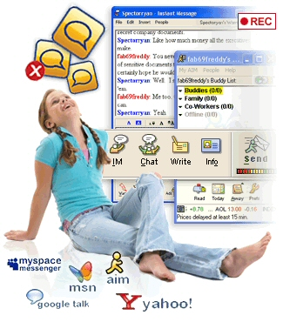
or
Cybercrime?
Hypercrime?
McGuire (2007): what distinguishes cyber (or virtual) space from “normal (or physical) space” is that it simply extends and complicates spacial interactions; it does not radically change those interactions.
Hyperspatialisation
Something that “does not produce new crime but simply expands already extant deviant possibilities”.

Slide 8
Cybercrime
suggests there are certain forms of crime that take place wholly and uniquely in something called cyberspace.
This, of course, is not possible.
Hypercrime
suggests a
more-sophisticated formulation:
While crimes themselves are always rooted in “normal space” certain forms of crime may, wholly or partly, be commissioned in hyperspace.

