Slide 1
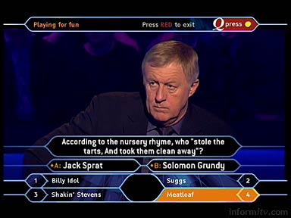
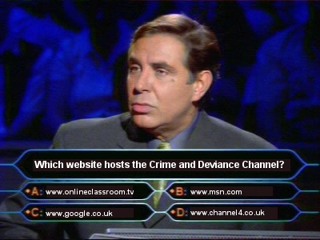
Who Wants To Be A Millionaire?
Crime and Deviance
Theories of Deviance 2
Click to Play

Slide 2
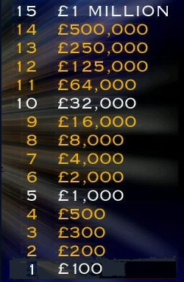
Who Wants To Be A Millionaire?
Crime and Deviance
Theories of Deviance 2
For Marxists, laws are created by and
reflect the interests of the:
A. Powerful
C. Proletariat
B. Poor
D. Police

Slide 3
Who Wants To Be A Millionaire?
Crime and Deviance
Theories of Deviance 2
Is the right answer
A. Powerful
C. Proletariat
B. Poor
D. Police

Slide 4
Who Wants To Be A Millionaire?
Crime and Deviance
Theories of Deviance 2
Order in Capitalist societies is
maintained through force and:
A. Compromise
C. Socialisation
B. Soft policing
D. Punishment

Slide 5
Who Wants To Be A Millionaire?
Crime and Deviance
Theories of Deviance 2
Is the right answer
A. Compromise
C. Socialisation
B. Soft policing
D. Punishment

Slide 6
Who Wants To Be A Millionaire?
Crime and Deviance
Theories of Deviance 2
According to Hall et al (1978)
who were scapegoated to deflect attention away from a crisis of capitalism?
A. Black muggers
C. Punks
B. Travellers
D. Street beggars

Slide 7
Who Wants To Be A Millionaire?
Crime and Deviance
Theories of Deviance 2
Is the right answer
A. Black muggers
C. Punks
B. Travellers
D. Street beggars

Slide 8
Who Wants To Be A Millionaire?
Crime and Deviance
Theories of Deviance 2
Marxists link increases in deviant behaviour to:
A. Criticisms of capitalism
C. Capitalism
B. Crises in capitalism
D. Crises at Christmas

Slide 9
Who Wants To Be A Millionaire?
Crime and Deviance
Theories of Deviance 2
Is the right answer
A. Criticisms of capitalism
C. Capitalism
B. Crises in capitalism
D. Crises at Christmas

Slide 10
Who Wants To Be A Millionaire?
Crime and Deviance
Theories of Deviance 2
For Willis (1977), subcultural development
among ‘the lads’ was an attempt to solve the problem of:
A. Status
C. Masculinity
B. Failure
D. Boredom

Slide 11
Who Wants To Be A Millionaire?
Crime and Deviance
Theories of Deviance 2
Is the right answer
A. Status
C. Masculinity
B. Failure
D. Boredom

Slide 12
Who Wants To Be A Millionaire?
Crime and Deviance
Theories of Deviance 2
Hall and Jefferson referred to youth
subcultures as involving what form of resistance?
A. Substantial
C. Symbolic
B. Hegemonic
D. Superior

Slide 13
Who Wants To Be A Millionaire?
Crime and Deviance
Theories of Deviance 2
Is the right answer
A. Substantial
C. Symbolic
B. Hegemonic
D. Superior

Slide 14
Who Wants To Be A Millionaire?
Crime and Deviance
Theories of Deviance 2
Which of the following is not an
example of a “spectacular” subculture?
A. Punks
C. Skinheads
B. Swingers
D. Mods

Slide 15
Who Wants To Be A Millionaire?
Crime and Deviance
Theories of Deviance 2
Is the right answer
A. Punks
C. Skinheads
B. Swingers
D. Mods

Slide 16
Who Wants To Be A Millionaire?
Crime and Deviance
Theories of Deviance 2
Dick Hebdidge wrote about the meaning of:
A. Symbols
C. Style
B. Labels
D. Status

Slide 17
Who Wants To Be A Millionaire?
Crime and Deviance
Theories of Deviance 2
Is the right answer
A. Symbols
C. Style
B. Labels
D. Status

Slide 18
Who Wants To Be A Millionaire?
Crime and Deviance
Theories of Deviance 2
Taylor, Walton and Young are associated
with what form of criminology?
A. Conventional
C. Constitutive
B. Corrective
D. Critical

Slide 19
Who Wants To Be A Millionaire?
Crime and Deviance
Theories of Deviance 2
Is the right answer
A. Conventional
C. Constitutive
B. Corrective
D. Critical

Slide 20
Who Wants To Be A Millionaire?
Crime and Deviance
Theories of Deviance 2
Whose study in Seattle showed a symbiotic relationship between control agencies and criminals?
A. Stan Cohen
C. Jock Young
B. William Chambliss
D. Stuart Hall

Slide 21
Who Wants To Be A Millionaire?
Crime and Deviance
Theories of Deviance 2
Is the right answer
A. Stan Cohen
C. Jock Young
B. William Chambliss
D. Stuart Hall

Slide 22
Who Wants To Be A Millionaire?
Crime and Deviance
Theories of Deviance 2
Who accused Taylor, Walton and Young of “romanticising criminals”?
A. Paul Q. Hirst
C. Jock Young
B. Stan Cohen
D. Robin P. Hood

Slide 23
Who Wants To Be A Millionaire?
Crime and Deviance
Theories of Deviance 2
Is the right answer
A. Paul Q. Hirst
C. Jock Young
B. Stan Cohen
D. Robin P. Hood

Slide 24
Who Wants To Be A Millionaire?
Crime and Deviance
Theories of Deviance 2
Who applied the term “Left Idealism” to the New Criminology of Taylor, Walton and Young?
A. Paul Taylor
C. Jock Young
B. Ian Walton
D. Paul Cohen

Slide 25
Who Wants To Be A Millionaire?
Crime and Deviance
Theories of Deviance 2
Is the right answer
A. Paul Taylor
C. Jock Young
B. Ian Walton
D. Paul Cohen

Slide 26
Who Wants To Be A Millionaire?
Crime and Deviance
Theories of Deviance 2
Which Marxist concept can be defined as “freedom within certain limits”?
A. Autonomy
C. Relative autonomy
B. Relative freedom
D. Autopoesis

Slide 27
Who Wants To Be A Millionaire?
Crime and Deviance
Theories of Deviance 2
Is the right answer
A. Autonomy
C. Relative autonomy
B. Relative freedom
D. Autopoesis

Slide 28
Who Wants To Be A Millionaire?
Crime and Deviance
Theories of Deviance 2
Cohen’s (1972) “loss of identity” thesis argued skinhead subcultures involved:
A. Symbolic space
C. Symbolic interaction
B. Realistic resistance
D. Fatalist acceptance

Slide 29
Who Wants To Be A Millionaire?
Crime and Deviance
Theories of Deviance 2
Is the right answer
A. Symbolic space
C. Symbolic interaction
B. Realistic resistance
D. Fatalist acceptance

Slide 30
Who Wants To Be A Millionaire?
Crime and Deviance
Theories of Deviance 2
Who characterised government in capitalist society as agents of a ruling class?
A. Quinney
C. Hall
B. Schwendinger
D. Jefferson

Slide 31
Who Wants To Be A Millionaire?
Crime and Deviance
Theories of Deviance 2
Is the right answer
A. Quinney
C. Hall
B. Schwendinger
D. Jefferson

Slide 32
Who Wants To Be A Millionaire?
Crime and Deviance
Theories of Deviance 2
Congratulations
Click to Exit

Slide 33
Who Wants To Be A Millionaire?
Crime and Deviance
Theories of Deviance 2
Is the wrong answer…
Click to Restart

