Slide 1
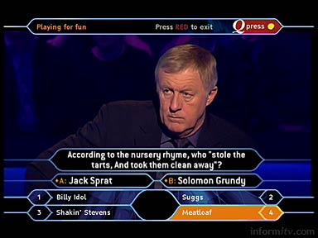
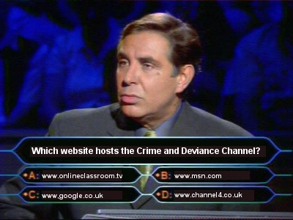
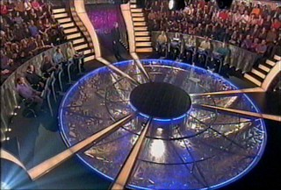
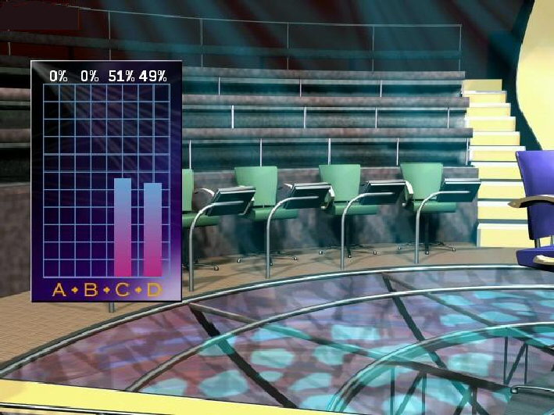
Who Wants To Be A Millionaire?
Crime and Deviance
Theories of Deviance
Click to Play

Slide 2
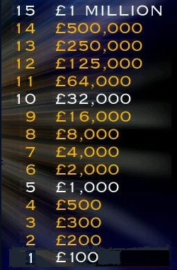
Who Wants To Be A Millionaire?
Crime and Deviance
Theories of Deviance
“Deviance” refers to what kind of behaviour?
A. Rule-breaking
C. Penny-pinching
B. Hedge-hopping
D. Dam-busting

Slide 3
Who Wants To Be A Millionaire?
Crime and Deviance
Theories of Deviance
Is the right answer
A. Rule-breaking
C. Penny-pinching
B. Hedge-hopping
D. Dam-busting

Slide 4
Who Wants To Be A Millionaire?
Crime and Deviance
Theories of Deviance
Which type of norm varies from group to group?
A. Legal
C. Informal
B. Formal
D. Inflexible

Slide 5
Who Wants To Be A Millionaire?
Crime and Deviance
Theories of Deviance
Is the right answer
A. Legal
C. Informal
B. Formal
D. Inflexible

Slide 6
Who Wants To Be A Millionaire?
Crime and Deviance
Theories of Deviance
Punishment for deviance is also known as a?
A. Positive sanction
C. Negative sanction
B. Legal sanction
D. Eiger sanction

Slide 7
Who Wants To Be A Millionaire?
Crime and Deviance
Theories of Deviance
Is the right answer
A. Positive sanction
C. Negative sanction
B. Legal sanction
D. Eiger sanction

Slide 8
Who Wants To Be A Millionaire?
Crime and Deviance
Theories of Deviance
The phrase “Deviance is not a quality of what someone does” is associated with?
A. Karl Marx
C. Robert Merton
B. Harold Garfinkel
D. Howard Becker

Slide 9
Who Wants To Be A Millionaire?
Crime and Deviance
Theories of Deviance
Is the right answer
A. Karl Marx
C. Robert Merton
B. Harold Garfinkel
D. Howard Becker

Slide 10
Who Wants To Be A Millionaire?
Crime and Deviance
Theories of Deviance
Deviant behaviour carried out with an awareness it is deviant is called?
A. Non-culpable deviance
C. Accountable deviance
B. Culpable deviance
D. Curable deviance

Slide 11
Who Wants To Be A Millionaire?
Crime and Deviance
Theories of Deviance
Is the right answer
A. Non-culpable deviance
C. Accountable deviance
B. Culpable deviance
D. Curable deviance

Slide 12
Who Wants To Be A Millionaire?
Crime and Deviance
Theories of Deviance
Which of the following is least likely to feature in Functionalist explanations of deviance?
A. Consensus
C. Control
B. Conformity
D. Conflict

Slide 13
Who Wants To Be A Millionaire?
Crime and Deviance
Theories of Deviance
Is the right answer
A. Consensus
C. Control
B. Conformity
D. Conflict

Slide 14
Who Wants To Be A Millionaire?
Crime and Deviance
Theories of Deviance
Which of the following is not, for Durkheim, a function of crime?
A. Social change
C. Social solidarity
B. Social exchange
D. Boundary-marking

Slide 15
Who Wants To Be A Millionaire?
Crime and Deviance
Theories of Deviance
Is the right answer
A. Social change
C. Social solidarity
B. Social exchange
D. Boundary-marking

Slide 16
Who Wants To Be A Millionaire?
Crime and Deviance
Theories of Deviance
Robert Merton is closely associated with which theory of deviance?
A. Strain
C. Conflict
B. Stress
D. Carcereal

Slide 17
Who Wants To Be A Millionaire?
Crime and Deviance
Theories of Deviance
Is the right answer
A. Strain
C. Conflict
B. Stress
D. Carcereal

Slide 18
Who Wants To Be A Millionaire?
Crime and Deviance
Theories of Deviance
Strain theory is what type of theory?
A. Reflexive
C. Proactive
B. Reductive
D. Reactive

Slide 19
Who Wants To Be A Millionaire?
Crime and Deviance
Theories of Deviance
Is the right answer
A. Reflexive
C. Proactive
B. Reductive
D. Reactive

Slide 20
Who Wants To Be A Millionaire?
Crime and Deviance
Theories of Deviance
In Shaw and McKay’s theory, which Zone always has the highest crime rates?
A. Suburban
C. Central business district
B. Green field
D. Interstitial

Slide 21
Who Wants To Be A Millionaire?
Crime and Deviance
Theories of Deviance
Is the right answer
A. Suburban
C. Central business district
B. Green field
D. Interstitial

Slide 22
Who Wants To Be A Millionaire?
Crime and Deviance
Theories of Deviance
Which of the following is not an aspect of the physical environment of crime?
A. Ethnic homogeneity
C. Millieu
B. Territoriality
D. Surveillance

Slide 23
Who Wants To Be A Millionaire?
Crime and Deviance
Theories of Deviance
Is the right answer
A. Ethnic homogeneity
C. Millieu
B. Territoriality
D. Surveillance

Slide 24
Who Wants To Be A Millionaire?
Crime and Deviance
Theories of Deviance
Which of the following is not a significant variable in Differential Association theory?
A. Frequency
C. Opacity
B. Intensity
D. Priority

Slide 25
Who Wants To Be A Millionaire?
Crime and Deviance
Theories of Deviance
Is the right answer
A. Frequency
C. Opacity
B. Intensity
D. Priority

Slide 26
Who Wants To Be A Millionaire?
Crime and Deviance
Theories of Deviance
Subcultures that develop
as a response to the prevailing norms and
values of a wider culture are called?
A. Reactionary
C. Independent
B. Reactive
D. Interdependent

Slide 27
Who Wants To Be A Millionaire?
Crime and Deviance
Theories of Deviance
Is the right answer
A. Reactionary
C. Independent
B. Reactive
D. Interdependent

Slide 28
Who Wants To Be A Millionaire?
Crime and Deviance
Theories of Deviance
Who argued that youth subcultures are the product of media labelling?
A. Albert Cohen
C. Paul Corrigan
B. Phil. Cohen
D. Stan. Cohen

Slide 29
Who Wants To Be A Millionaire?
Crime and Deviance
Theories of Deviance
Is the right answer
A. Albert Cohen
C. Paul Corrigan
B. Phil. Cohen
D. Stan. Cohen

Slide 30
Who Wants To Be A Millionaire?
Crime and Deviance
Theories of Deviance
Who suggested the term “neo-tribes” should be used instead of youth subcultures?
A. Ken. Plummer
C. Michele Barrett
B. Stan. Cohen
D. Andy Bennett

Slide 31
Who Wants To Be A Millionaire?
Crime and Deviance
Theories of Deviance
Is the right answer
A. Ken. Plummer
C. Michele Barrett
B. Stan. Cohen
D. Andy Bennett

Slide 32
Who Wants To Be A Millionaire?
Crime and Deviance
Theories of Deviance
Congratulations
Click to Exit

Slide 33
Who Wants To Be A Millionaire?
Crime and Deviance
Theories of Deviance
Is the wrong answer…
Click to Restart

