Slide 1
The
Sociological
Detectives
investigate…

Slide 2
Differential Educational Achievement
Crime Scene
Briefing
Previous Work

Slide 3
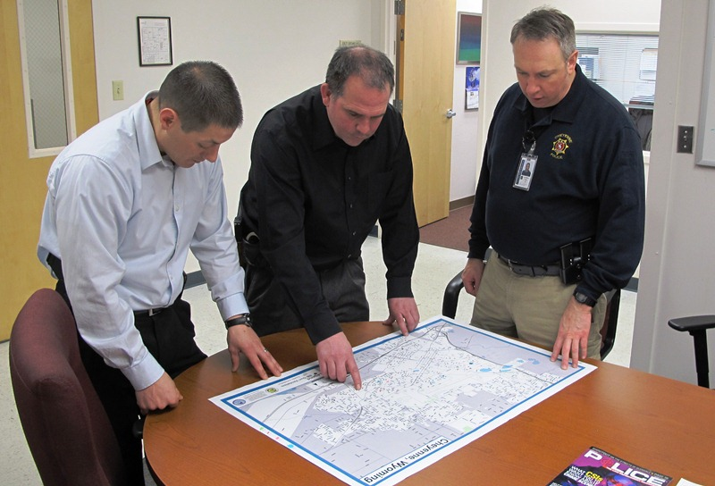
Briefing
You have been selected to form a new team charged with reinvestigating Differential Educational Achievement.
Your task is to:
Identify suspects
Gather evidence
Identify and explore theories
Write and submit individual reports to your team leader for performance assessment and evaluation

Slide 4
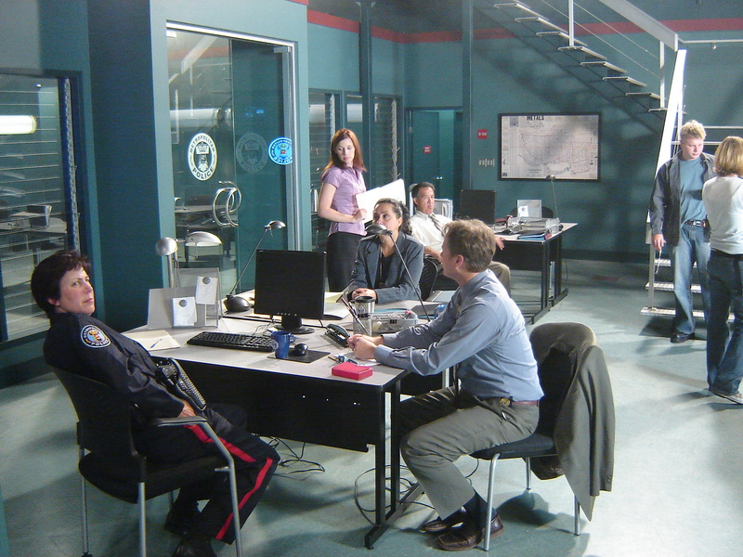
Previous work
Previous work on the case has identified three major areas of interest:
Focus on
these at all times
Class differences Gender differences Ethnic differences
It also discovered:
Possible sources of evidence
Potential lines of enquiry
Review these?

Slide 5
Crime Scene Clues?
Hidden
Curriculum
Parental
Attitudes
Peer
Pressure
Patriarchy

Slide 6
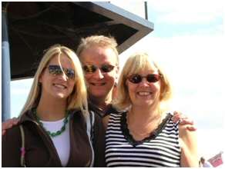
Suspect?
How do families influence educational achievement?
Family
Potential lines of enquiry?
Material Deprivation | Family structures
Genetic Inheritance | Cultural Capital
Parental Attitudes | Cultural Deprivation
Class Subcultures | Gender Socialisation

Slide 7
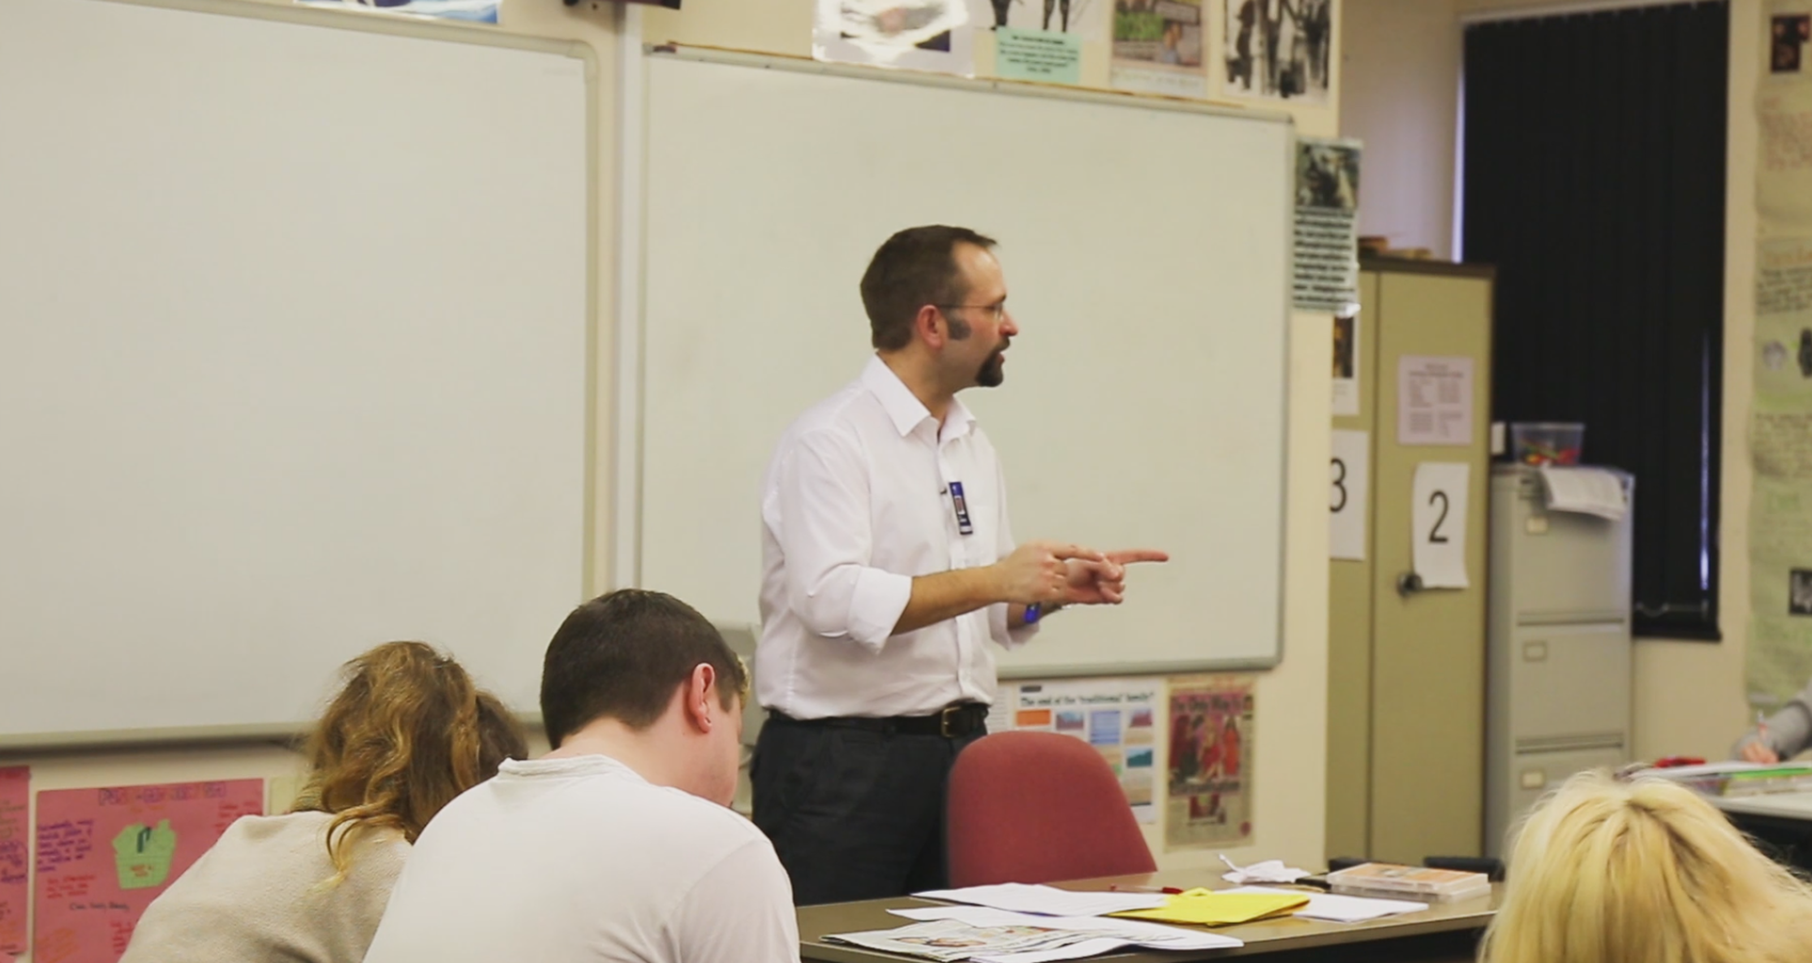
Suspect?
How do schools influence educational achievement?
School
Potential lines of enquiry?
Hidden Curriculum Labelling and Stereotypes Class / race / sex Discrimination Ideological State Apparatus Curriculum | Social inclusion / exclusion Streaming, Banding, Setting Type of school Correspondance theory IQ

Slide 8
Suspect?
How do peers influence educational achievement?
Peer
Group
Potential lines of enquiry?
Identities
Gender socialisation | Peer Pressure
Gendered Curriculum | Masculinity / femininity
Pupil Subcultures – pro / anti school / education

Slide 9
Suspect?
How does work influence educational achievement?
Work
Potential lines of enquiry?
Employment Opportunities Sexual Discrimination Racial Discrimination Patriarchal Attitudes | Correspondance Theory Globalisation Labour market changes

Slide 10
Evidence?
Ready to Report?
test the Theories!
Family
Possible sources of evidence?
Material Deprivation | Situational Constraints
Genetic Inheritance | Cultural Capital
Parental Attitudes | Cultural Deprivation
Class Subcultures | Gender Socialisation

Slide 11
Evidence?
Ready to Report?
test the Theories!
School
Possible sources of evidence?
The Hidden Curriculum Labelling and Stereotypes Class Discrimination Sex Discrimination | Racial Discrimination Streaming Banding and Setting

Slide 12
Evidence?
Ready to Report?
test the Theories!
Peer
Group
Possible sources of evidence?
Peer Pressure
Gender socialisation
Gendered Curriculum
Pupil Subcultures

Slide 13
Evidence?
Ready to Report?
test the Theories!
Work
Possible sources of evidence?
Employment Opportunities Sexual Discrimination Racial Discrimination Patriarchal Attitudes

Slide 14
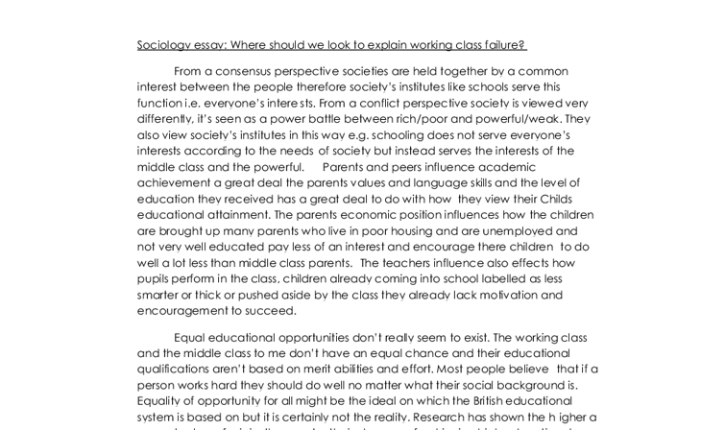
Report?
Combine suspects, evidence and theories
Prepare a case examining all sides of the question
“Evaluate the view that differences in educational achievement between social groups are the result of factors and processes within schools”
Credits

Slide 15
Design and Implementation
shortcutstv.com
Chris Livesey

