Slide 1
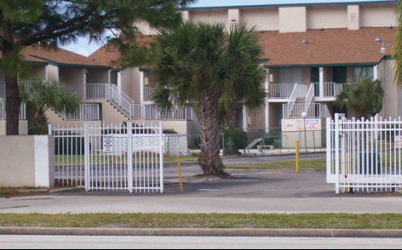
Situational Crime Prevention
Five Strategies and
Twenty-Five Techniques
Cornish and Clarke (2003)

Slide 2
Strategies and Techniques
Cornish and Clarke (2003)
Strategies
Increase Effort
Reduce Reward
Reduce Stimulus
Remove Excuses
Increase Risk
Situational Crime Prevention
Notes:
Main Menu: 5 major categories of situational crime prevention
Click a circle (e.g. Increase Risk) to go to techniques and Examples screen for that category

Slide 3
Strategies and Techniques
Cornish and Clarke (2003)
Harden Targets
Screen Exits
Deflect Offenders
Control Tools
Control Access
Situational Crime Prevention
Harden Targets
Physical barriers to obstruct offender access to a potential target:
E.g. Locks, Anti-robbery screens.
Control Tools
Universal measures to control tools and weapons used in crime:
E.g. Access to guns and knives, electronic disabling of phones, cars, etc.
Strategies
Reduce Reward
Reduce Stimulus
Remove Excuses
Increase Risk
Increase Effort
Control Access
Barriers to access to vulnerable areas:
E.g. Entry phones, Electronic keys, Alleygates.
Deflect Offenders
Provide alternatives for activities:
E.g. Youth meeting areas, litter bins, streaming music services.
Screen Exits
E.g. Electronic tags / devices in shops to prevent theft.
Increase Effort
Notes:
Strategy Screen (e.g. Increase Effort)
Each of the 5 circles represents a situational crime prevention Technique for a specific Strategy.
Click a circle (e.g. Harden Targets) to show a brief explanation and examples.
Click the circle again if you want to hide the explanation and examples.
The centre circle is a navigation menu for the Presentation: click the centre (blue) Strategies circle to go back to Main Menu or click one of the other coloured circles to go to the relevant Technique screen.

Slide 4
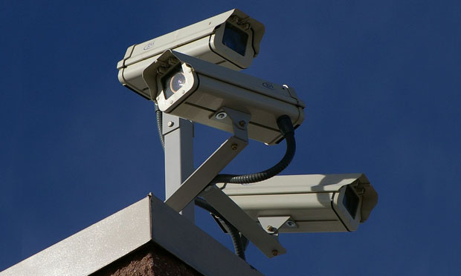
Strategies and Techniques
Cornish and Clarke (2003)
Extend
Guardian ship
Reduce Anonymity
Utilise
Site Managers
Strengthen Formal Surveillance
Assist Natural Surveillance
Situational Crime Prevention
Extend Guardianship
Extending the number of “eyes on the street” to enhance safety:
E.g. Reporting suspicious incidents, Neighbourhood Watch, “Cell-phone surveillance”.
Strengthen Formal Surveillance
Deterring unwanted activities through clearly-visible surveillance:
E.g. Uniformed security guards, CCTV, alarms.
Strategies
Reduce Reward
Reduce Stimulus
Remove Excuses
Increase Risk
Increase Effort
Assist Natural Surveillance
Making it easier for people to surveil areas as they go about their normal business.
E.g. Improved street lighting, Defensible space.
Utilise Site Managers
People conduct soft surveillance in the course of their work.
E.g. Attendants, maintenance workers, porters. Reward vigilance.
Reduce Anonymity
Develop ways to increase people’s familiarity with each another.
E.g. Identity cards in taxis, school uniforms.
Increase Risk

Slide 5
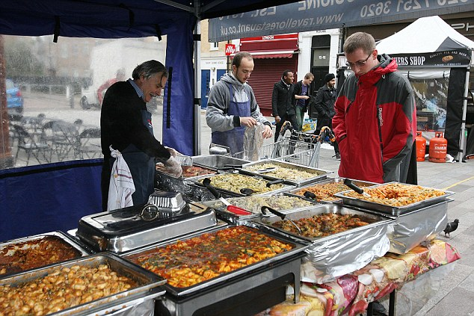
Strategies and Techniques
Cornish and Clarke (2003)
Conceal Targets
Identify Property
Disrupt Markets
Deny Benefits
Remove Targets
Situational Crime Prevention
Deny Benefits
Deterring offenders by denying them the benefits of crime:
E.g. PIN numbers on debit cards, photos on credit cards, rapid graffiti removal, clothing ink tags.
Conceal Targets
Reduce chances of victimisation by keeping potential targets out of plain view:
E.g. Unmarked bullion trucks, hiding jewellery, phones, etc. while walking alone, off-street parking.
Remove Targets
Reduce chances of victimisation by securing potential targets:
E.g. Women’s refuges, not carrying cash in public, securing valuable property overnight.
Strategies
Reduce Reward
Reduce Stimulus
Remove Excuses
Increase Risk
Increase Effort
Disrupt Markets
Reduce market for stolen goods to discourage burglary and theft:
E.g. Licensing street vendors, monitoring pawn shops, identity cards for door-to-door salespeople.
Identify Property
Using indelible ownership marks on property to prevent reselling:
E.g. Ultra-violet marking of computers etc.
Reduce Reward

Slide 6
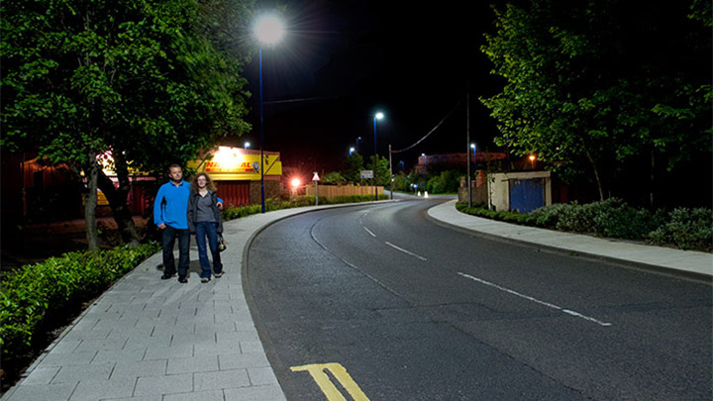
Strategies and Techniques
Cornish and Clarke (2003)
Reduce Stress
Reduce Emotional Arousal
Neutralise Peer Pressure
Discourage Imitation
Avoid Disputes
Situational Crime Prevention
Reduce Frustration and Stress
Measures to calm / change people’s mood:
E.g. Improved street / workplace lighting, online services to reduce queues, public seating, polite assistants.
Discourage Imitation
Measures to prevent “copy-cat” offending:
E.g. Rapid repair of vandalised property (“Broken Windows”), parental controls on TV programming.
Avoid Disputes
Measures designed to prevent disputes arising:
E.g. Fixed cab fares, traffic reduction measures, separating rival fans in stadia, reduced crowding in pubs.
Strategies
Reduce Reward
Reduce Stimulus
Remove Excuses
Increase Risk
Increase Effort
Neutralise Peer Pressure
Measures to reduce negative or promote positive influence of peers:
E.g. Zero-tolerance of school bullying, anti-drug campaigns, “friends don’t let friends drink-and-drive”.
Reduce Emotional Arousal
Measures to eliminate emotional responses:
E.g. Banning hate speech, convicted paedophiles not housed near schools.
Reduce Stimulus

Slide 7
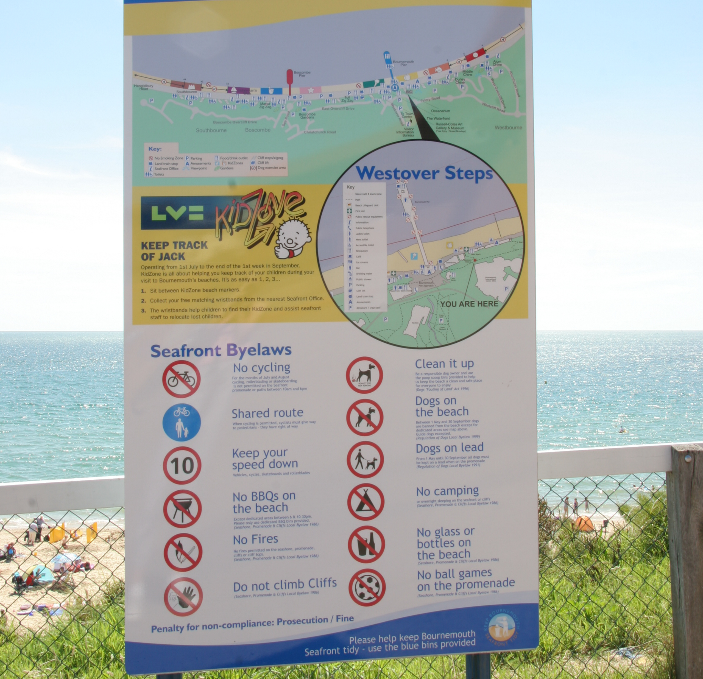
Strategies and Techniques
Cornish and Clarke (2003)
Set
Rules
Alert People’s Conscience
Assist Compliance
Control Drug Abuse
Promote Rules
Situational Crime Prevention
Set Rules
Clear and concise rules to encourage compliance:
E.g. Signed student agreements, codes of conduct for schools, organisations, etc.
Control Drug Abuse
Develop ways to control effects of drug and alcohol abuse:
E.g. Legalising / licensing marijuana, free breathalyser tests in pubs, designated driver schemes, improved training for bartenders.
Promote Rules
Make people aware of behavioural rules:
E.g. Signs (“No parking”, “No smoking”).
Strategies
Reduce Reward
Reduce Stimulus
Remove Excuses
Increase Risk
Increase Effort
Assist Compliance
Measures that help people conform:
E.g. Non-alcoholic drinks, litter bins, public lavatories.
Alert People’s Conscience
Use people’s moral values to influence their behaviour:
E.g. Warning signs for speeding, “Piracy is a crime” warnings on CDs and DVDs, “Please do not litter” appeals in public places.
Remove Excuses

